Slide 1
Arranging Schedule
Distributed by Group 4

Slide 2
Members of the group
Nguyễn Văn Huy
Trần Tuấn Phong
Nguyễn Ngọc Khánh
Bùi Hồng Nhật

Slide 3
Table of contents
1
4
2
5
3
6
About this problem
Greedy
What do we need to solve ?
CP solution
MIP solution
A method using ortools.
Another method using ortools
Local search
More Information
A closer look to each algorithm

Slide 4
1
About this problem

Slide 5
Arranging schedule
There are N classes 1, 2, …, N arranging student schedule. t(i), g(i), s(i) is the number of shift, teacher, the number of student, respectively.
There are M rooms 1, 2, …, M, while c(i) is the number of seat in the room i.
In one week have 5 days (from Monday to Friday), each day consist of 12 shifts (6 morning shifts and 6 afternoon shifts).
Let’s create a student schedule (determine weekday, shift and the room for each class)
Two class having the same teacher need setting in different time
The number of student in each class is smaller than the capacity of the classroom
Input:
The first line: N and M.
The next N line, each line write: t(i), g(i) and s(i).
The next line: c(1), c(2), …, c(n).
Output:
Student schedule

Slide 6
CP solution
2

Slide 7
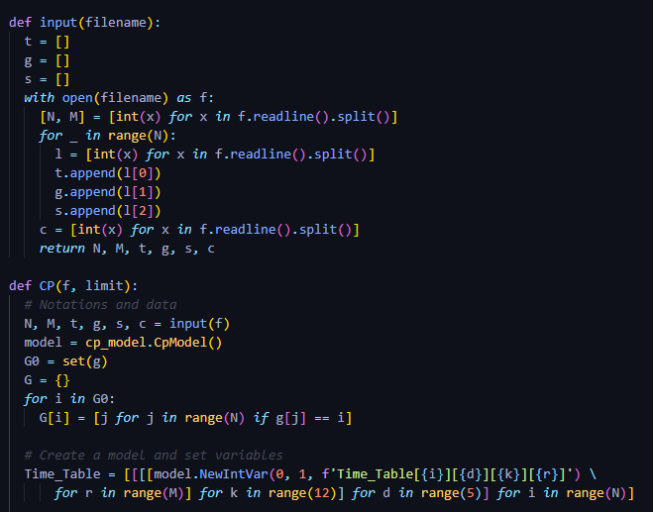
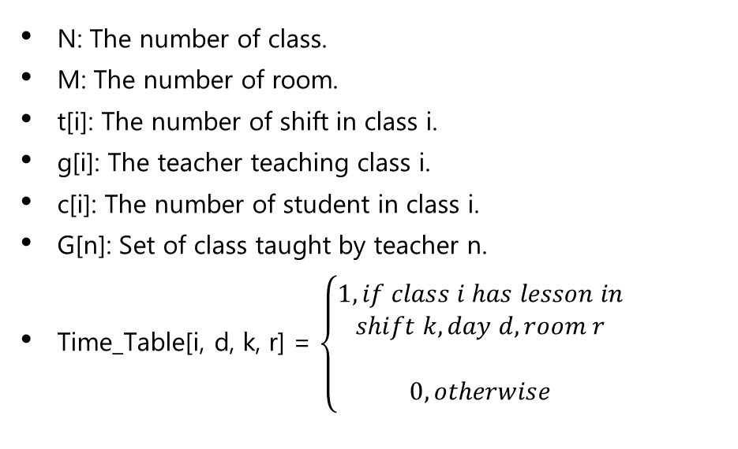
CP Variables
N: The number of class.
M: The number of room.
t[i]: The number of shift in class i.
g[i]: The teacher teaching class i.
c[i]: The number of student in class i.
G[n]: Set of class taught by teacher n.
Time_Table[i, d, k, r] = $\left\{\begin{aligned}1, if class i has lesson in \\ shift k, day d, room r \\ \\ 0, otherwise\end{aligned}\right.$

Slide 8
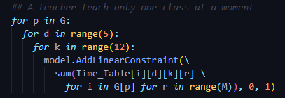
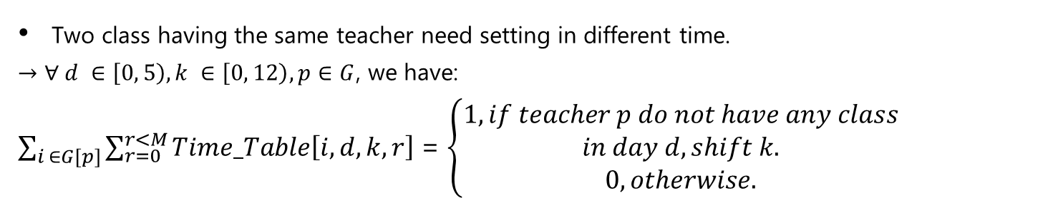
CP Constraints
Two class having the same teacher need setting in different time.
$→$ $∀ d ∈\left[0, 5\right), k ∈\left[0, 12\right), p∈G$, we have:
$\sum_{i ∈G[p]}{\sum_{r=0}^{r<M}{Time_Table\left[i, d, k, r\right]}}$ = $\left\{\begin{aligned}1, if teacher p do not have any class \\ in day d, shift k. \\ 0, otherwise.\end{aligned}\right.$

Slide 9
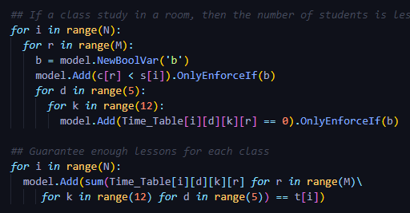
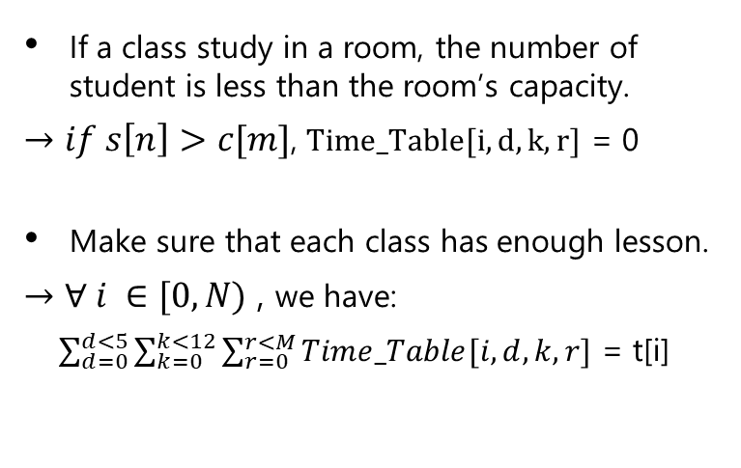
CP Constraints
If a class study in a room, the number of student is less than the room’s capacity.
$→if s\left[n\right]>c[m]$, $Time_Table[i, d, k, r]$ = 0
Make sure that each class has enough lesson.
$→$ $∀ i ∈[0, N)$ , we have:
$\sum_{d=0}^{d<5}{\sum_{k=0}^{k<12}{\sum_{r=0}^{r<M}{Time_Table[i, d, k, r]}}}$ = t[i]

Slide 10
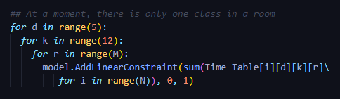
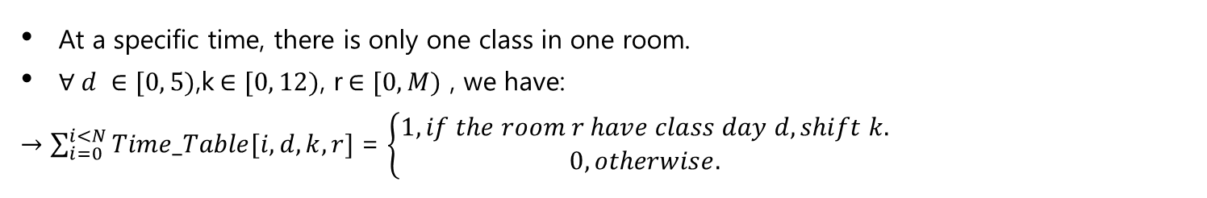
CP Constraints
At a specific time, there is only one class in one room.
$∀ d ∈[0, 5)$,k$∈[0, 12)$, r$∈[0, M)$ , we have:
$→\sum_{i=0}^{i<N}{Time_Table[i, d, k, r]}$ = $\left\{\begin{aligned}1, if the room r have class day d, shift k. \\ 0, otherwise.\end{aligned}\right.$

Slide 11
5
MIP SOLUTION

Slide 12
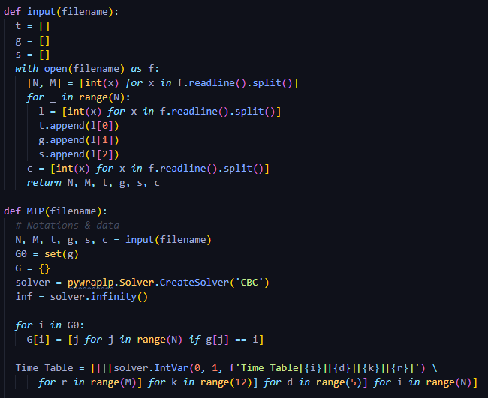
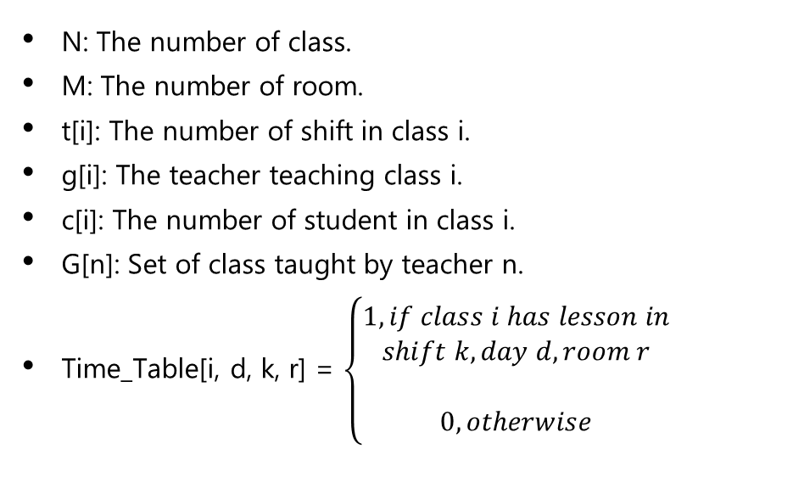
MIP Variables
N: The number of class.
M: The number of room.
t[i]: The number of shift in class i.
g[i]: The teacher teaching class i.
c[i]: The number of student in class i.
G[n]: Set of class taught by teacher n.
Time_Table[i, d, k, r] = $\left\{\begin{aligned}1, if class i has lesson in \\ shift k, day d, room r \\ \\ 0, otherwise\end{aligned}\right.$

Slide 13
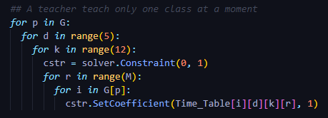
MIP Constraints
Two class having the same teacher need setting in different time.
$→$ $∀ d ∈\left[0, 5\right), k ∈\left[0, 12\right), p∈G$, we have:
$\sum_{i ∈G[p]}{\sum_{r=0}^{r<M}{Time_Table\left[i, d, k, r\right]}}$ = $\left\{\begin{aligned}1, if teacher p do not have any class \\ in day d, shift k. \\ 0, otherwise.\end{aligned}\right.$

Slide 14
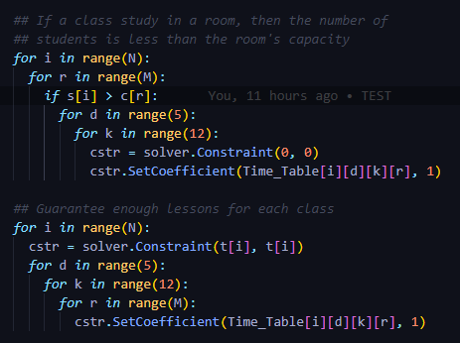
MIP Constraints
If a class study in a room, the number of student is less than the room’s capacity.
$→if s\left[n\right]>c[m]$, $Time_Table[i, d, k, r]$ = 0
Make sure that each class has enough lesson.
$→$ $∀ i ∈[0, N)$ , we have:
$\sum_{d=0}^{d<5}{\sum_{k=0}^{k<12}{\sum_{r=0}^{r<M}{Time_Table[i, d, k, r]}}}$ = t[i]

Slide 15
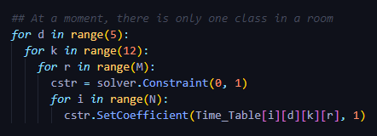
MIP Constraints
At a specific time, there is only one class in one room.
$∀ d ∈[0, 5)$,k$∈[0, 12)$, r$∈[0, M)$ , we have:
$→\sum_{i=0}^{i<N}{Time_Table[i, d, k, r]}$ = $\left\{\begin{aligned}1, if the room r have class day d, shift k. \\ 0, otherwise.\end{aligned}\right.$

Slide 16
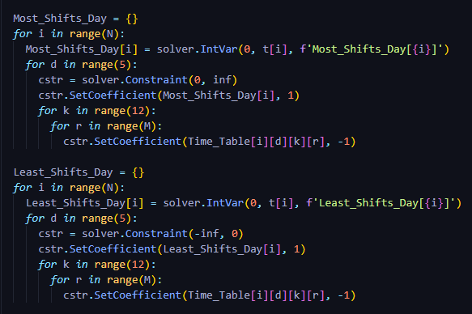
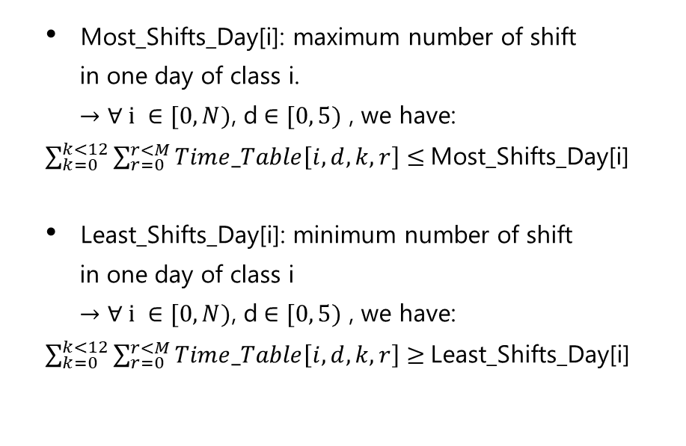
MIP Constraints
Most_Shifts_Day[i]: maximum number of shift
in one day of class i.
$→$ $∀ i ∈[0, N)$, d$∈[0, 5)$ , we have:
$\sum_{k=0}^{k<12}{\sum_{r=0}^{r<M}{Time_Table\left[i, d, k, r\right]}}$ $≤$Most_Shifts_Day[i]
Least_Shifts_Day[i]: minimum number of shift
in one day of class i
$→$ $∀ i ∈[0, N)$, d$∈[0, 5)$ , we have:
$\sum_{k=0}^{k<12}{\sum_{r=0}^{r<M}{Time_Table\left[i, d, k, r\right]}}$ $≥$Least_Shifts_Day[i]

Slide 17
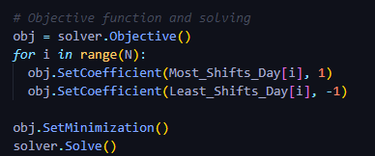
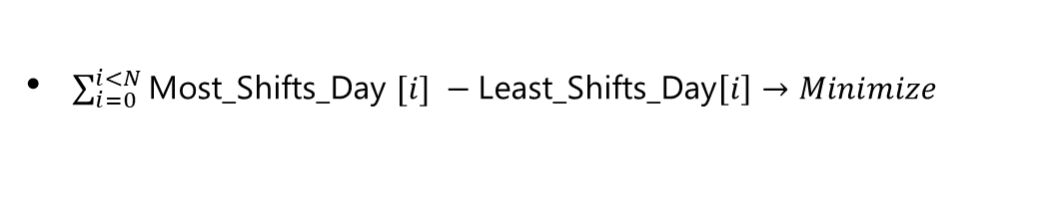
MIP Objective Function
$\sum_{i=0}^{i<N}{\text{Most}\text{_}\text{Shifts}\text{_}\text{Day} [i]} −\text{Least}\text{_}\text{Shifts}\text{_}\text{Day}\left[i\right]→Minimize$

